Slide 1
Group 1: Presentation 2 IMDCGD111-15YRD Ubisoft Adversarial Brief
James Pyke
Matthew Lummis
Benjamin Attebery

Slide 2
Logline
Teams compete to control outposts whilst avoiding enemy fire.
Each team will progress through an enemy’s territory to capture the final base.

Slide 3
Genre
Demographic
Base Capture Game for 2-4 players
Predominantly males: 16-45
Hard fun and People Fun - Strategy and Goals as well as Social bonding and competition.

Slide 4
Objective
First team to capture the enemy’s home base wins.
Tug-of-war based strategy

Slide 5
Physics Mechanics
Recoil
Augment movement
Risk involved as it can negatively impact your positioning
Knockback
Deny opponent capturing outposts and bases through knockback from projectiles.

Slide 6
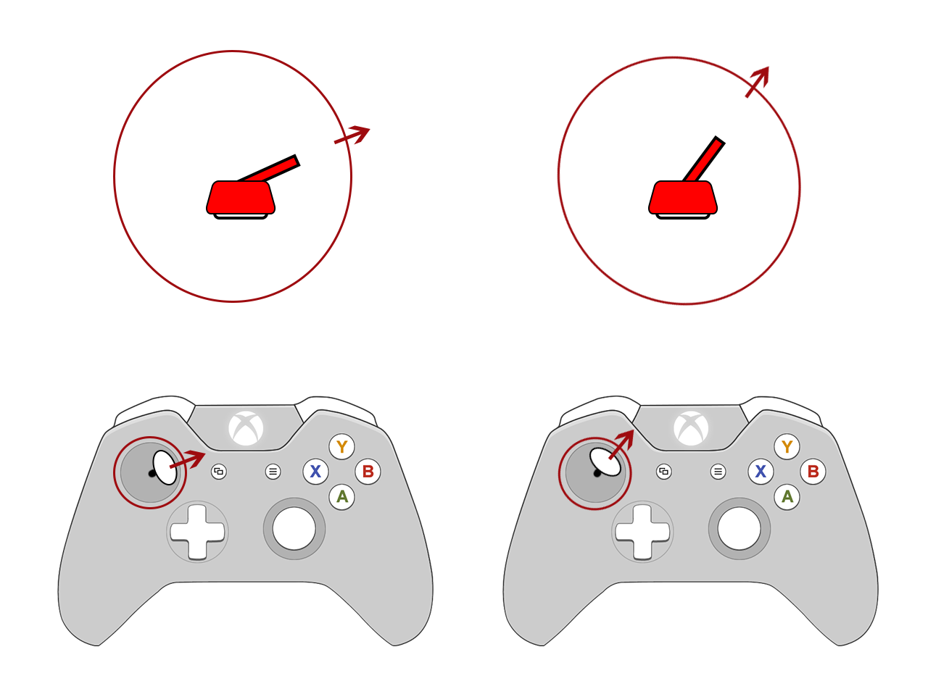
What the Player Does
Direction

Slide 7
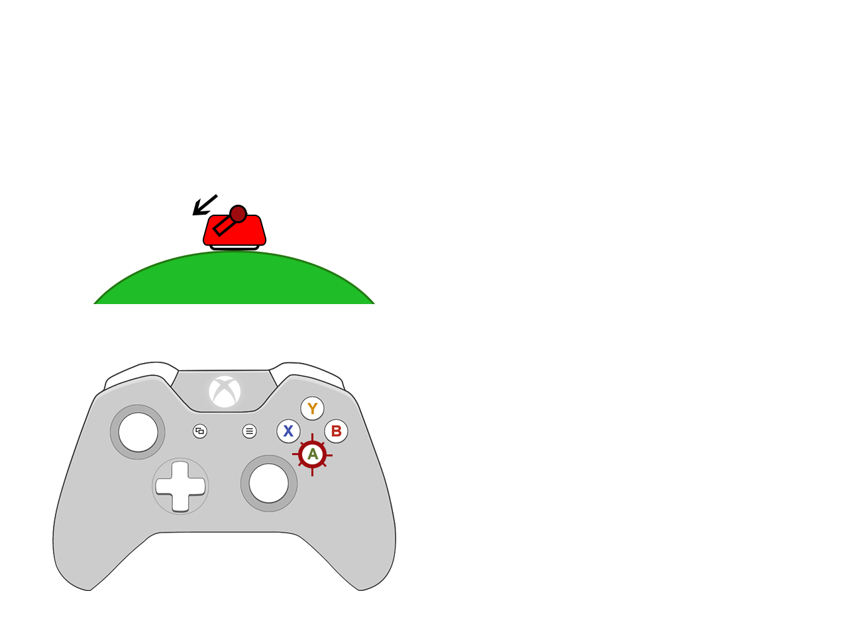
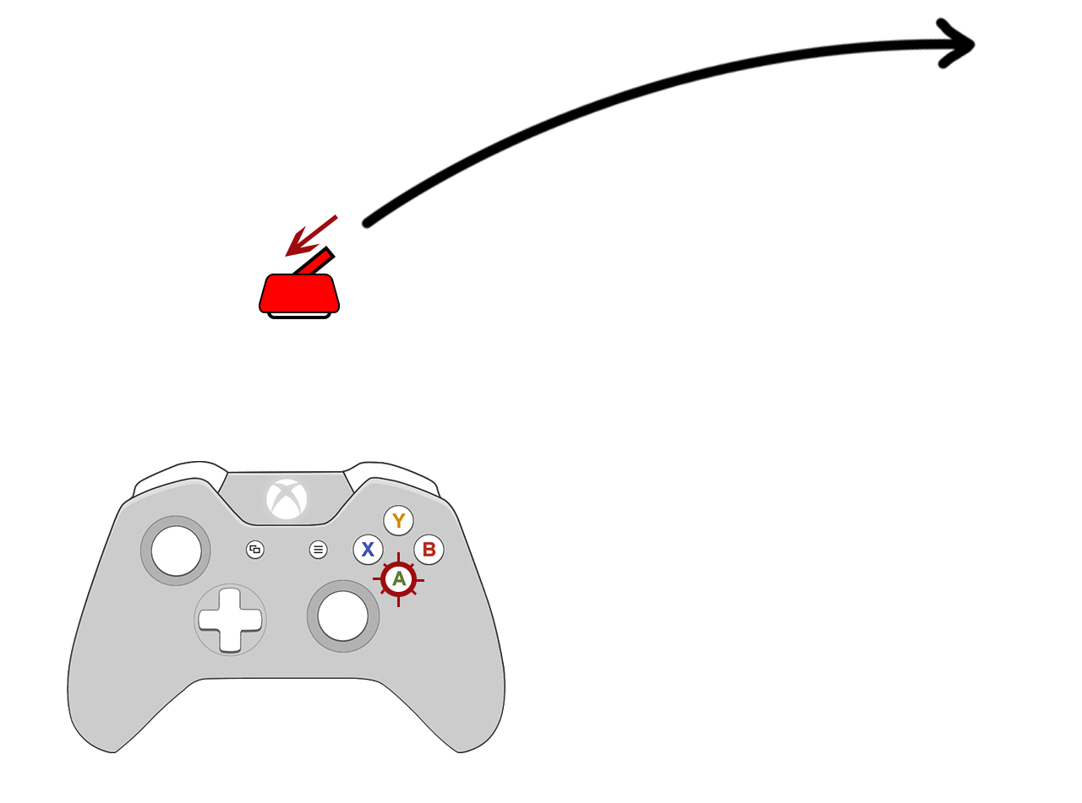
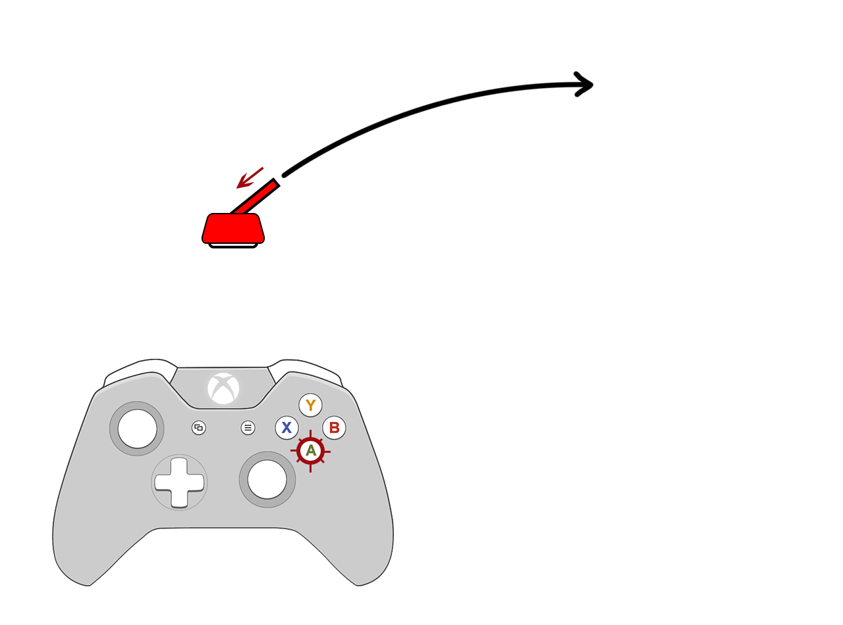
Main Mechanic
Recoil

Slide 8
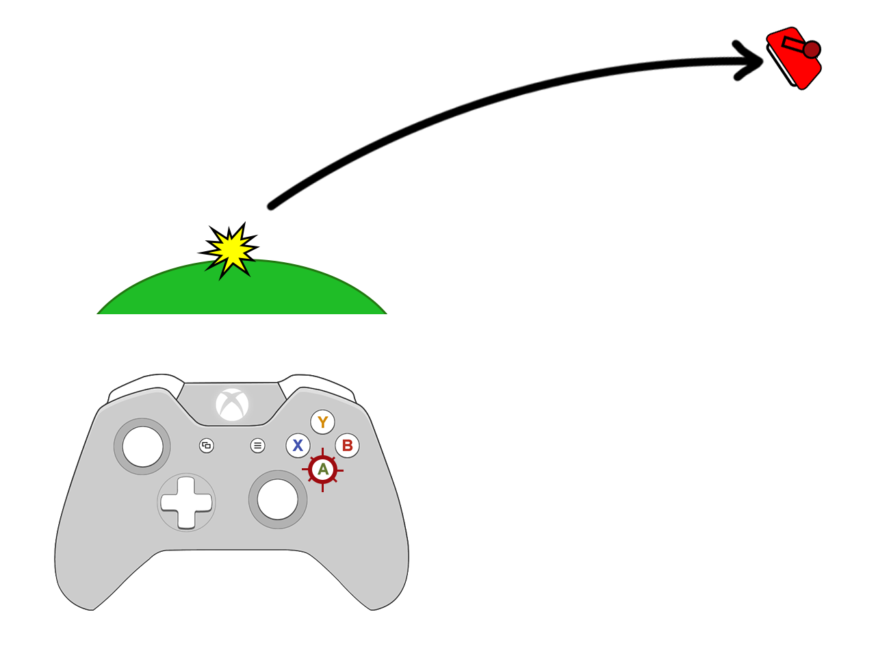
Main Mechanic
Recoil

Slide 9
Level Design / Art Style
2D top down
Sliding screen arena

Slide 10
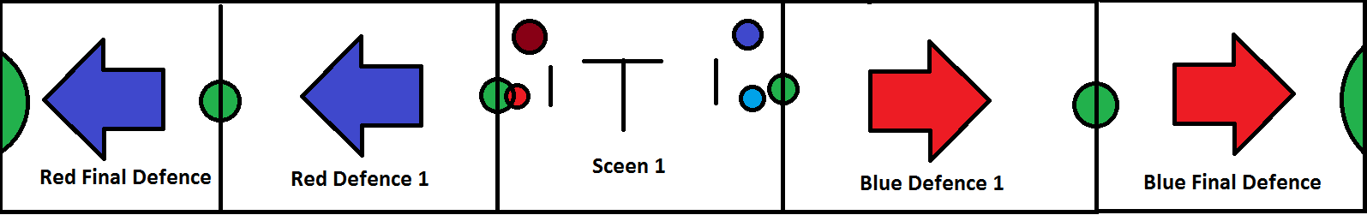
Level Design/Layout
Red Team
Blue Team
Capture Points

Slide 11

Level Theme/Layout
Concept Characters

Slide 12
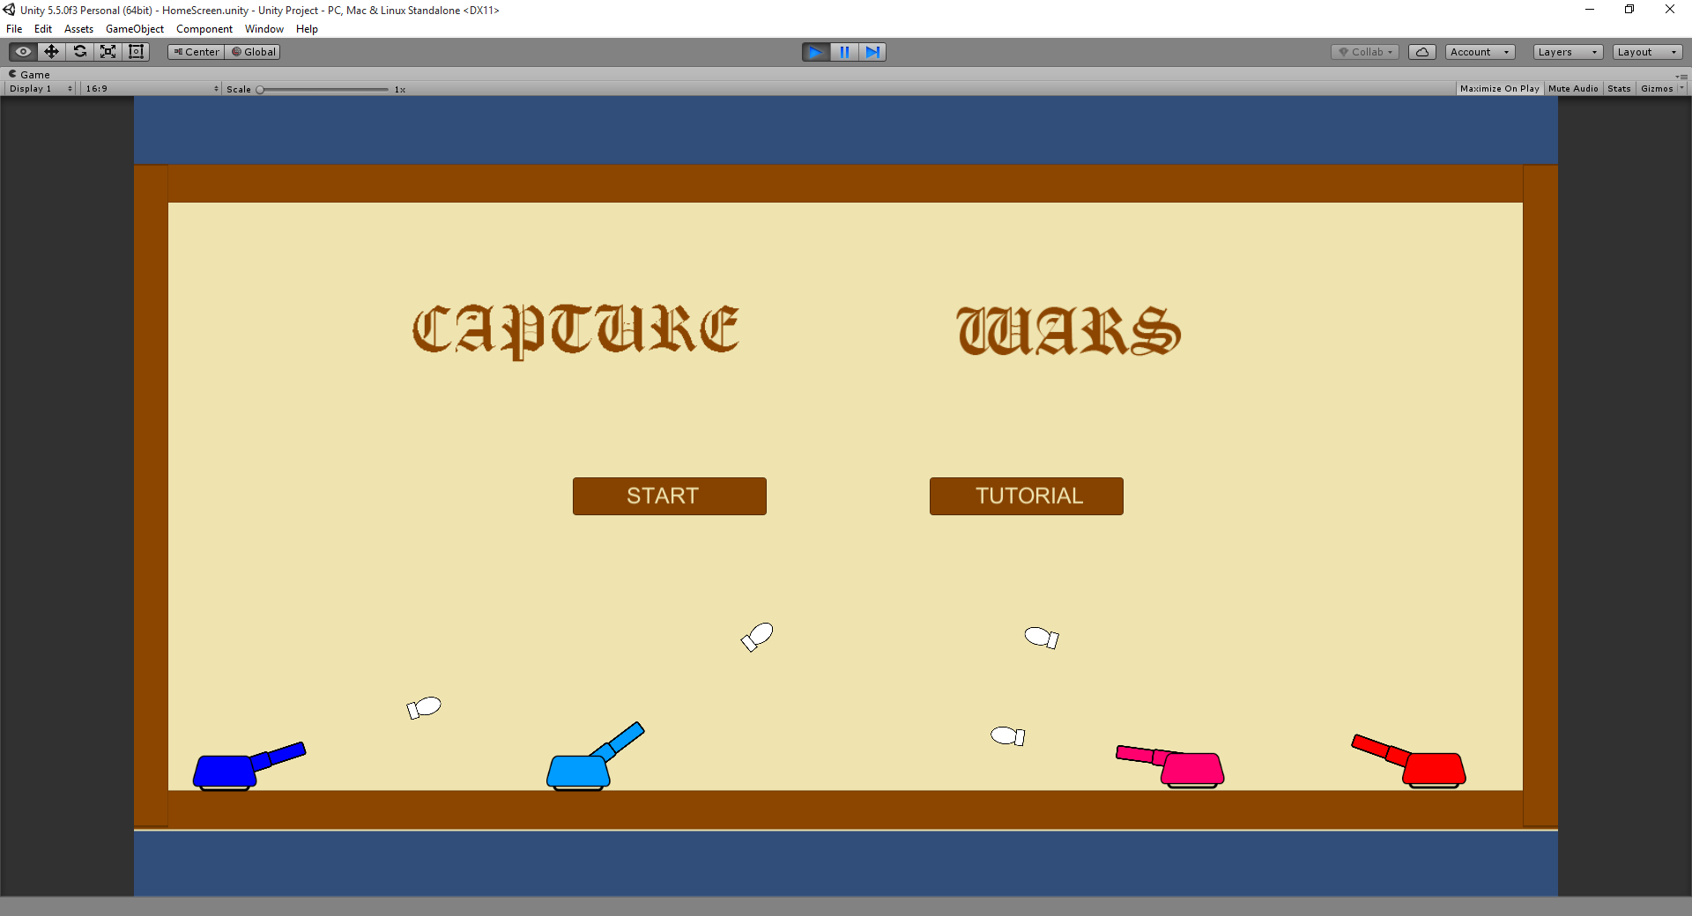
First Iteration of Game

Slide 13
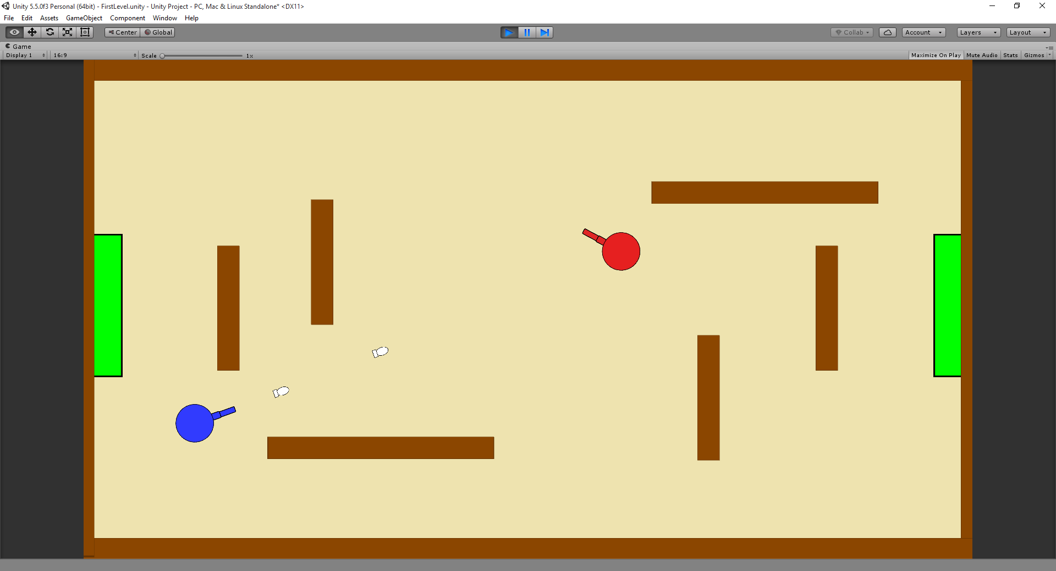
First Iteration of Game

Slide 14
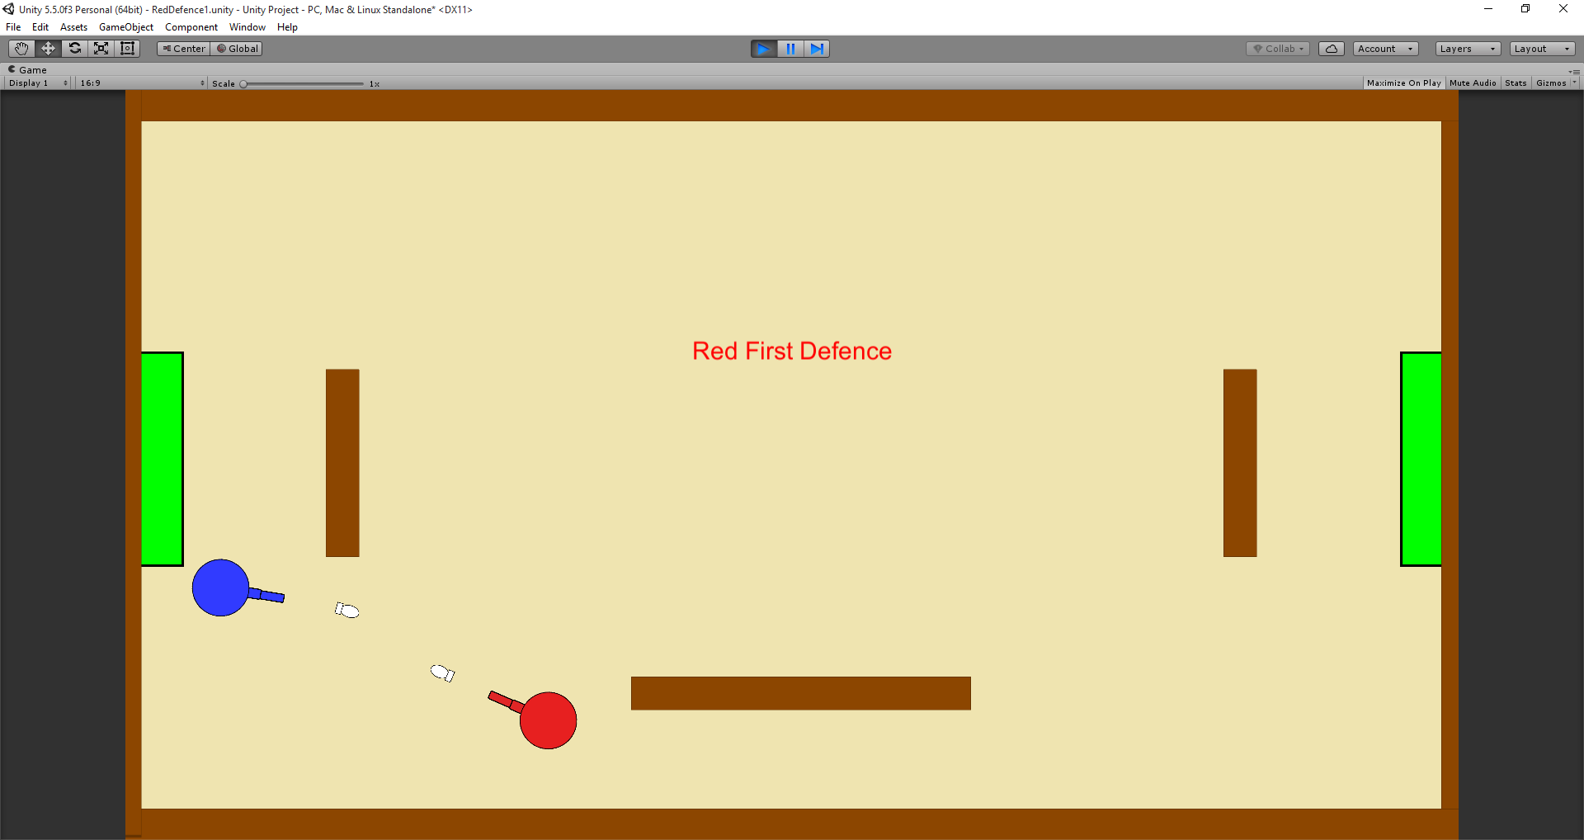
First Iteration of Game

Slide 15
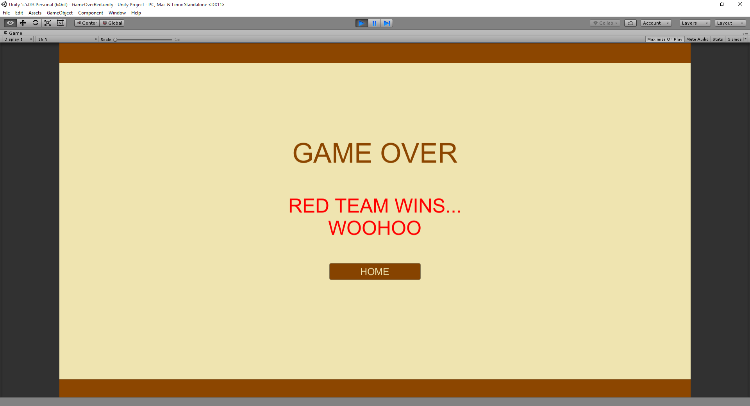
First Iteration of Game

Slide 16
Any Questions?

